Slide 1
Pat-a-Cake, Pat-a-Cake!

Slide 2
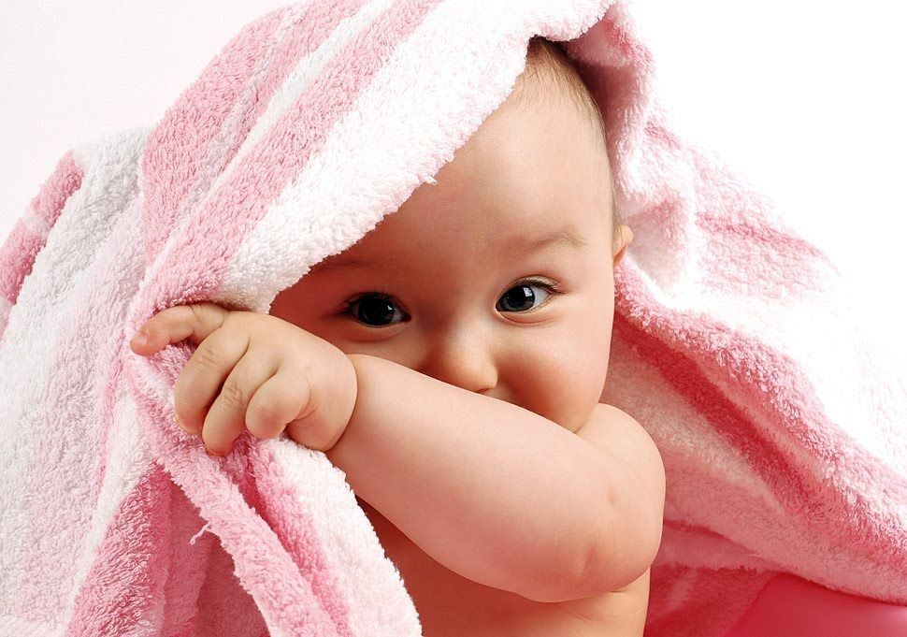
Peek-A-Boo
On last week we played, Peek-A-Boo. Tell me some of the exciting ways you played, Peek-A-Boo.

Slide 3
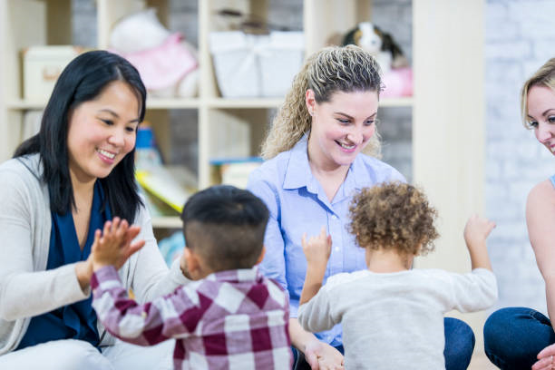
Pat-a-Cake, Pat-a-Cake!
Let’s focus on the child’s eye-hand coordination skills. Sit the child on your lap and play a hand game.
Tell the child to touch your hand as you raise it in the air.

Slide 4
Pat-a-Cake
https://www.youtube.com/watch?v=WeYBmJPswe0

Slide 5
Show Me Your Hand(s)
This is a great time to identify the child's hand-eye coordination. Raise your hands and say, “these are your hands.”
Infant: Wave your hands slowly in front of their face. Make sure their eyes are following your hands. Let’s get creative, get a ribbon and wave it in front of the child’s face.
Toddlers: Point to your hand and say, “hand.” This allows the child to identify their hands. Now point and say fingers. This will allow the child to understand the difference between their fingers and their hand.

Slide 6
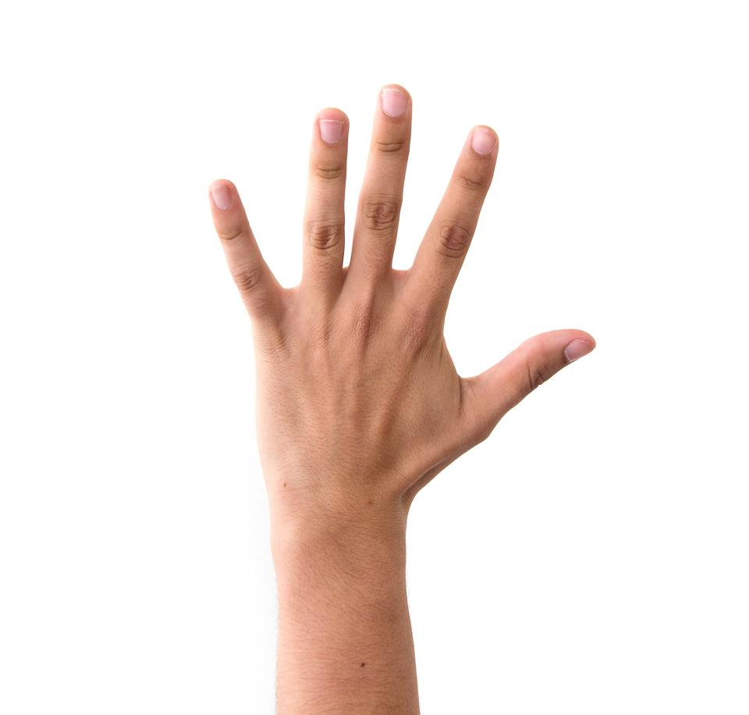
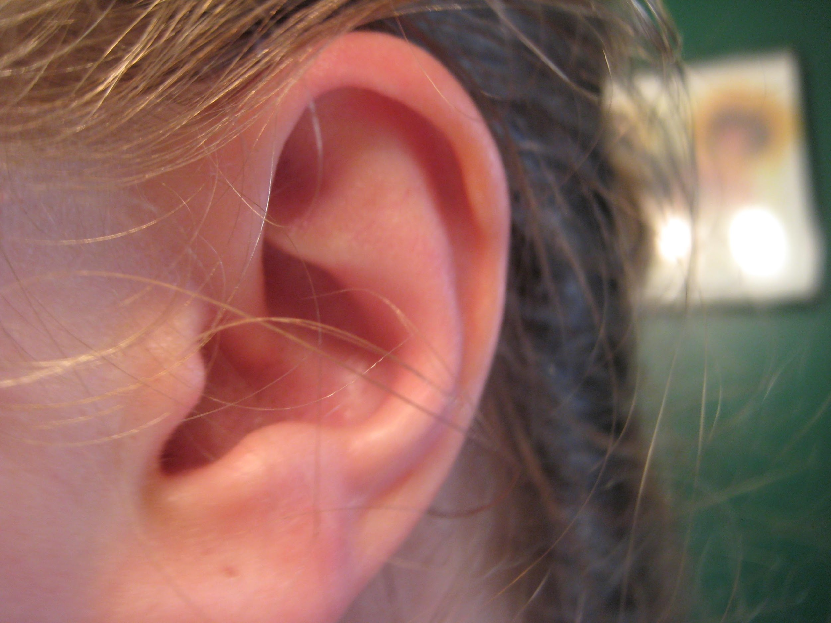
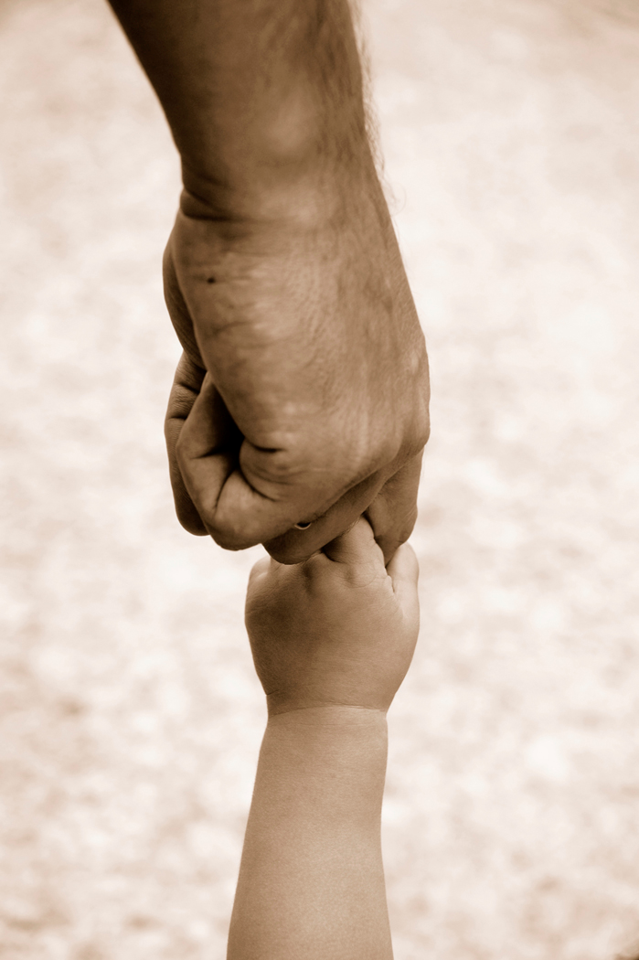
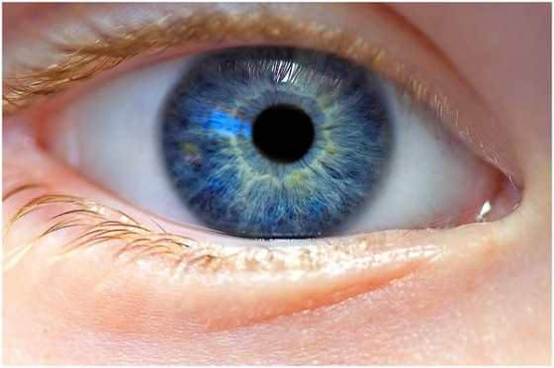
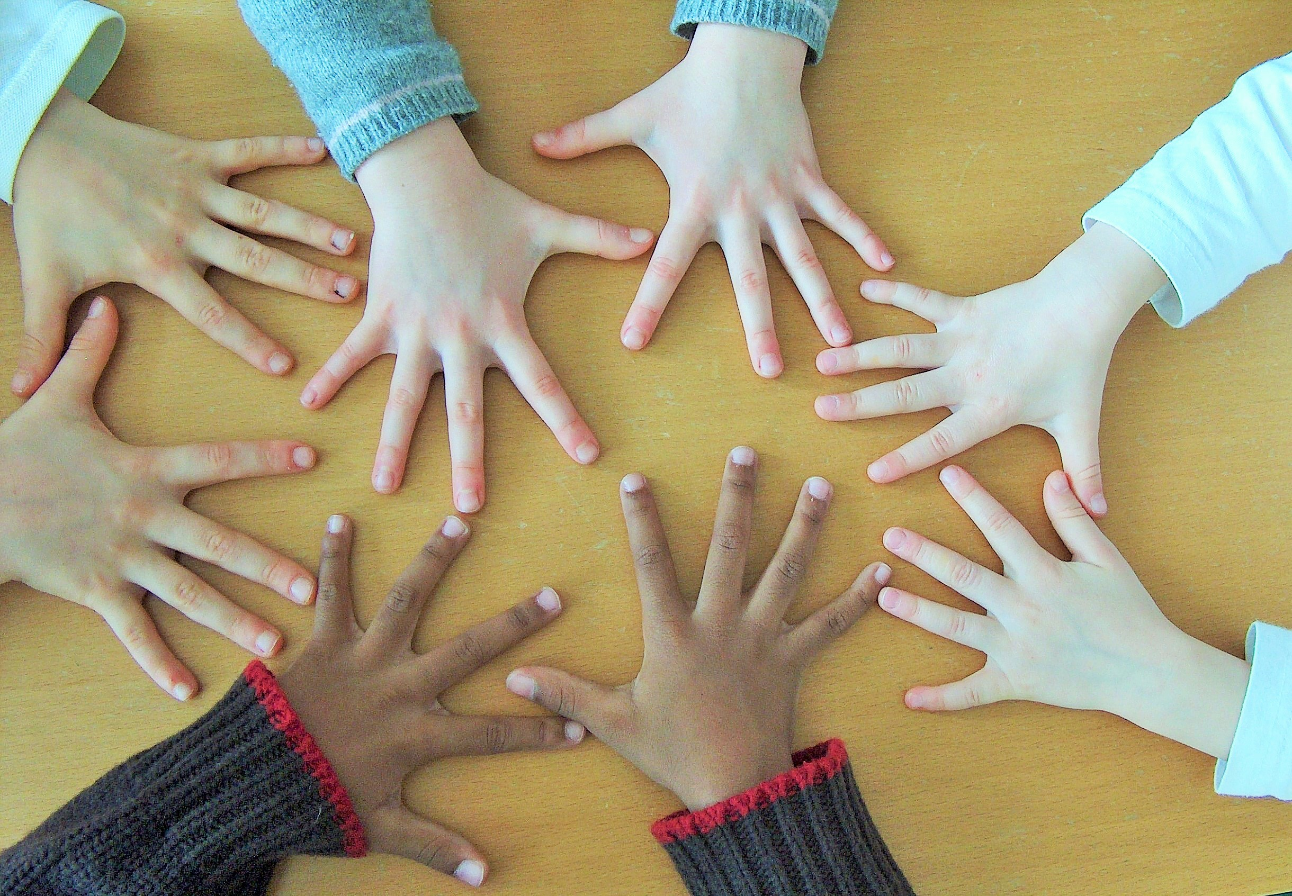
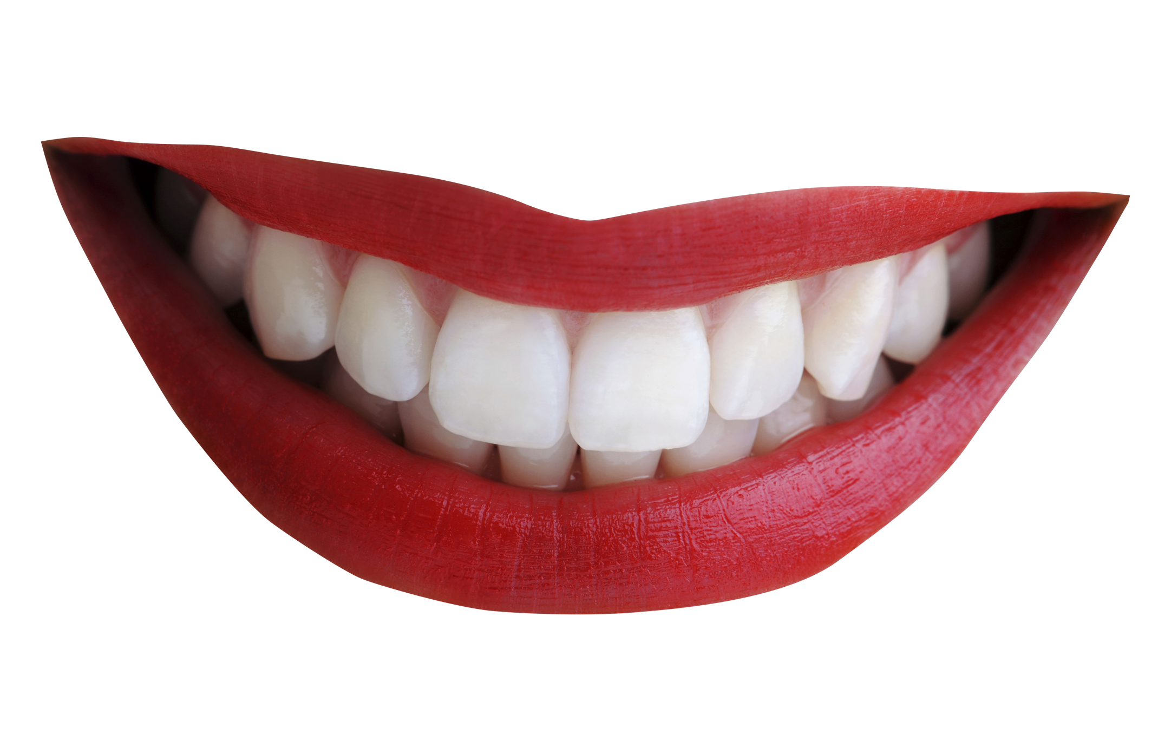
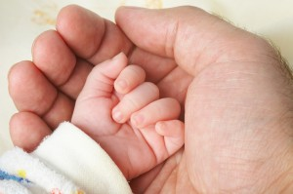
Point at the hand.

Slide 7
Hand, Hand, Fingers, Thumb by Al Perkins
https://www.youtube.com/watch?v=QUnpROr3-Po

Slide 8
Family Activities

Slide 9
Create an Activity Board
Infant:
Find objects that are colorful and stimulating (things that would get the child’s attention). Make sure you put the board within arms reach for the child to play with the board. Watch as the child reach or grab for items on the board. This helps them with hand-eye coordination.

Slide 10
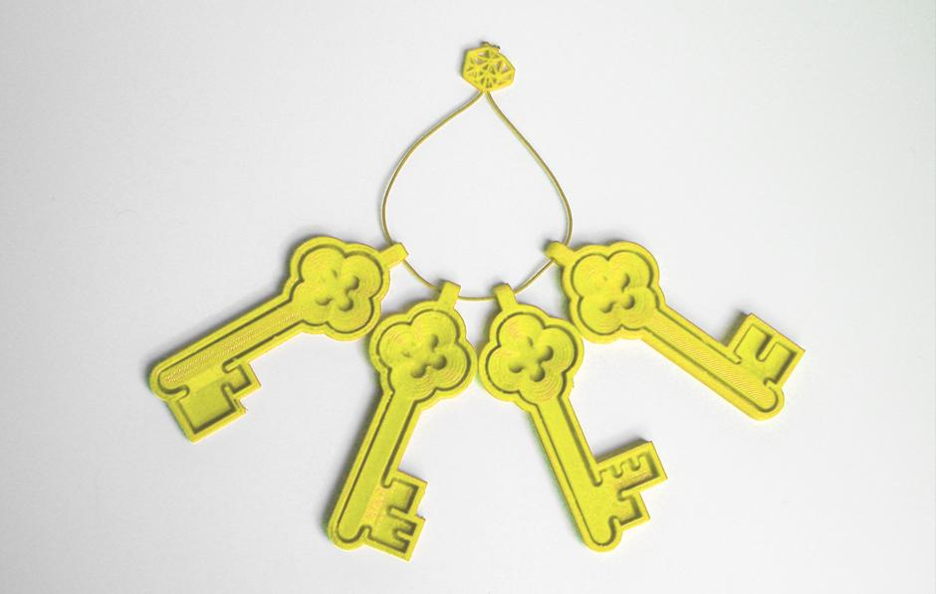
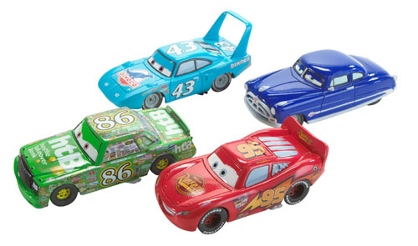
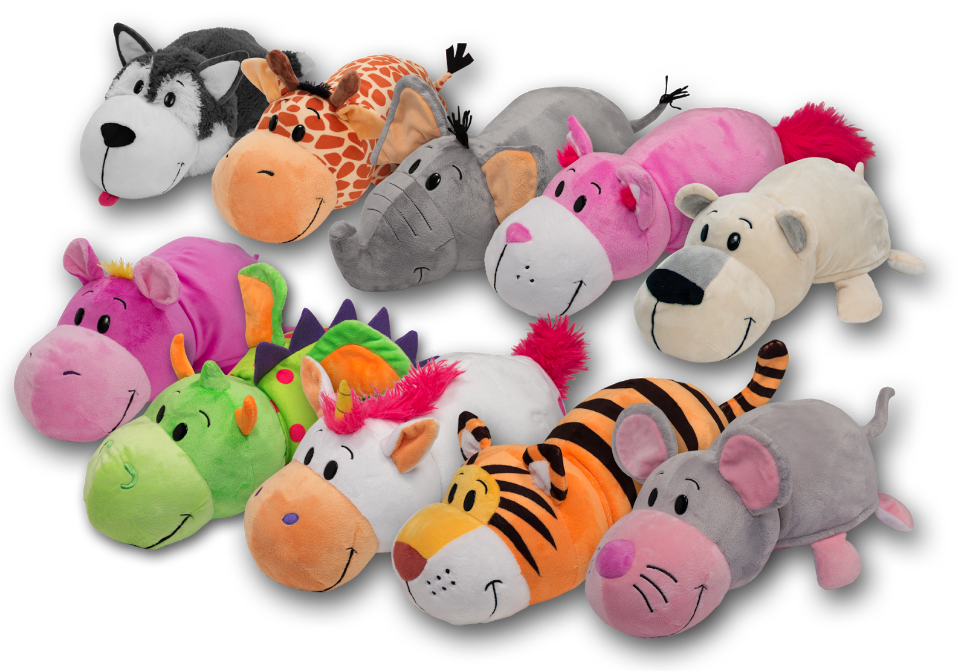
Grab and Hold
Toddlers:
Create a mystery box. This is an empty box filled with items. Inside of the mystery box put items like:
scarves, keys, something furry/soft, a flower, toy cars, a bean, etc.
As the child is feeling in the mystery box ask him/her, “what do think you are feeling?” Ask the child, “how does this feel?”

Slide 11
Let’s Play Catch
Put the child in front of you and tell them to catch. You can use a balloon, a soft ball, a piece of paper, a ribbon, etc. Throw this object softly for the child to catch it.

Slide 12
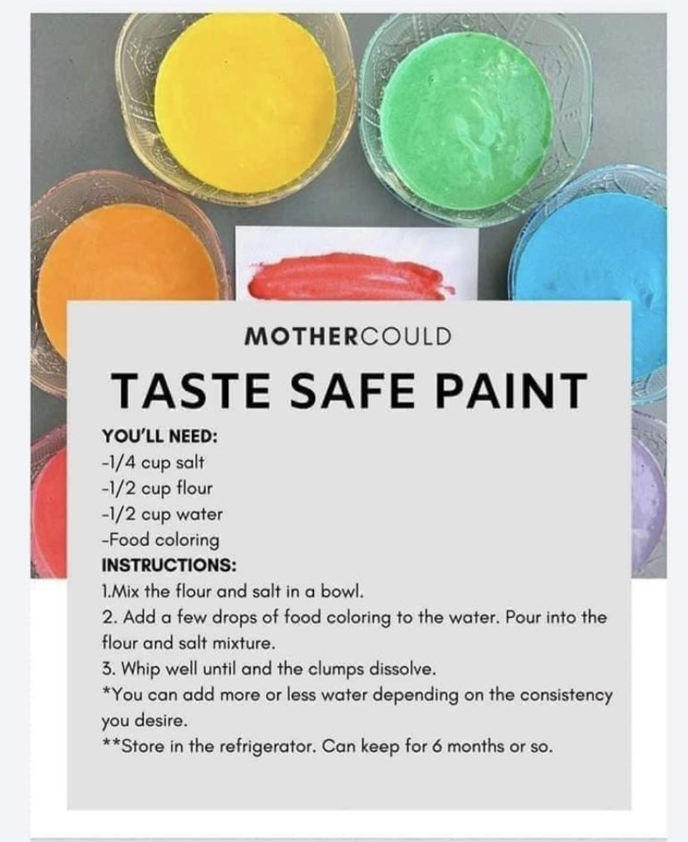
Finger Painting.
Let’s make our own finger paint.

Slide 13
Grab and Hold Paint
This is a great activity for you and the child to do together.

Slide 14
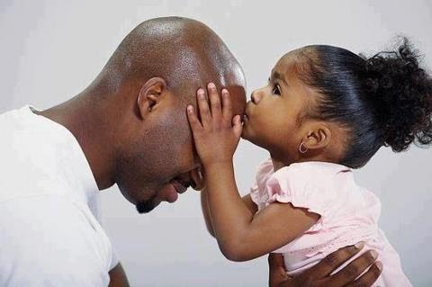
Additional Resources
https://www.youtube.com/watch?v=LRFZfSFNOM8
Milestones for 3 month olds.
https://www.youtube.com/watch?v=ocFxdf-lmsQ
Milestones for 18 month olds.
https://www.youtube.com/watch?v=0nFqrBIc8eg
How to make homemade baby food?

Slide 15
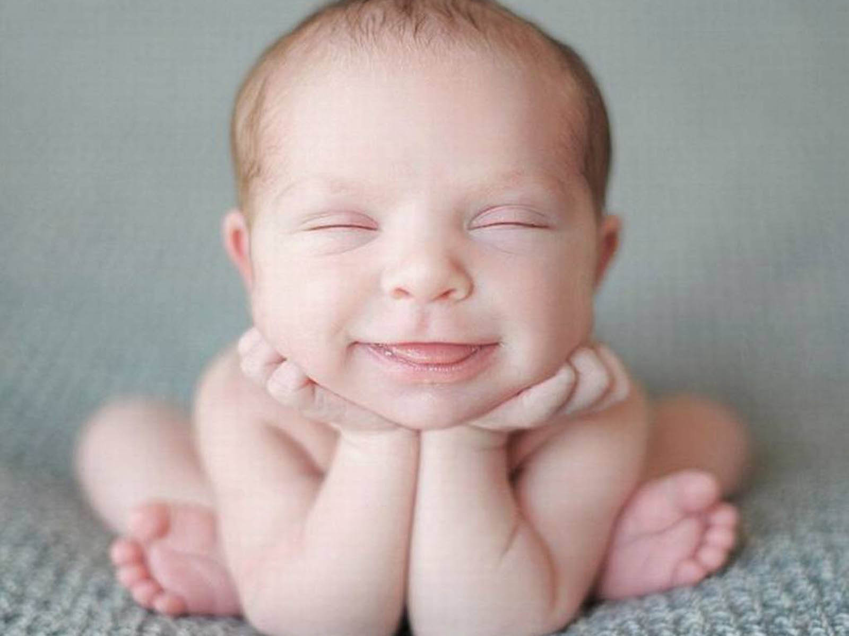
References
https://www.youtube.com/watch?v=LRFZfSFNOM8
Milestones for 3 month olds.
https://www.youtube.com/watch?v=ocFxdf-lmsQ
Milestones for 18 month olds.
https://www.youtube.com/watch?v=0nFqrBIc8eg
How to make homemade baby food?
https://www.mothercould.com
Paint Activities
https://www.youtube.com/watch?v=QUnpROr3-Po
Hands, Hands, Fingers, Thumbs
This Photo by Unknown Author is licensed under CC BY-SA

